Slide 1
Introduction to Unit Testing

Slide 2
Why?
Hands on
Unit testing with Junit 4
Mocking objects with Mockito
Integration testing with Spring Test

Slide 3
The vicious cycle
Code
Deploy
Test

Slide 4
Real life scenario
Core module
Module A
Module C
Module D
Module B
Module E
We need to change something here!

Slide 5

And then this happens…

Slide 6

It works yesterday!!!

Slide 7
What is Unit Testing
A unit test is an automated and self checked procedure used to validate that a particular unit of source code works correctly
In Java, a unit is a single Java class
The class under test should be tested in isolation.

Slide 8
Unit Testing vs Integration Testing
Component A
Component B
Component C

Slide 9
Enough talking, let’s code!

Slide 10
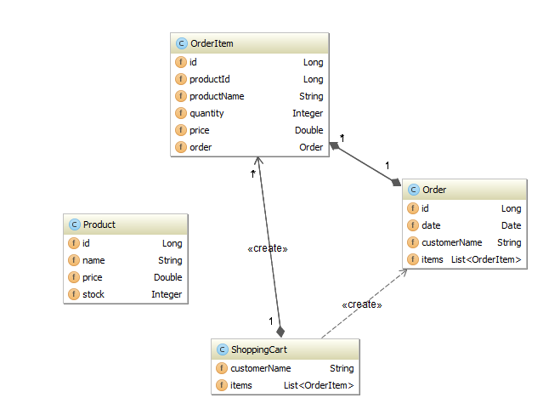
The Classic Problem – Shopping Cart

Slide 11
Testing Principles
Fast
Isolated
Repeatable
Self-verifying
Timely

Slide 12
The benefits of Unit Testing
Isolate each part of the program and the that the individual parts work
Strict, written contract that the piece of code must satisfy
Allows to refactor code and make sure is still works correctly

Slide 13
What’s next
Test Driven Development
Code Coverage
UI Testing

